Slide 1
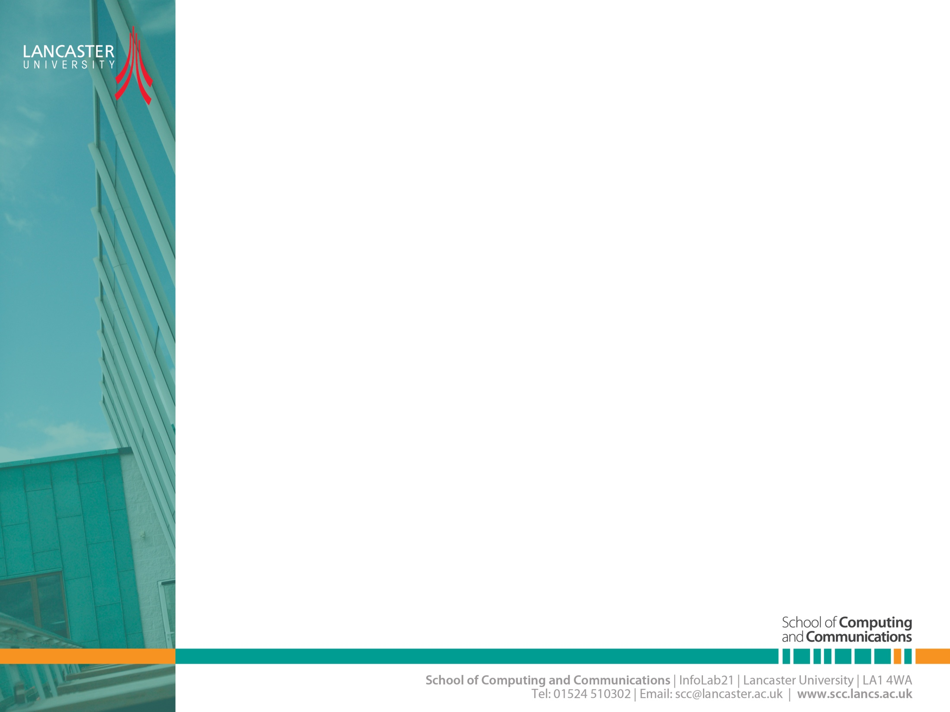

MIMO-INTRODUCTION
CNSCC.405
Digital Signal Processing
Dr Muhammad Abrar (Dr. MAB)
m.abrar@lancaster.ac.uk

Slide 2
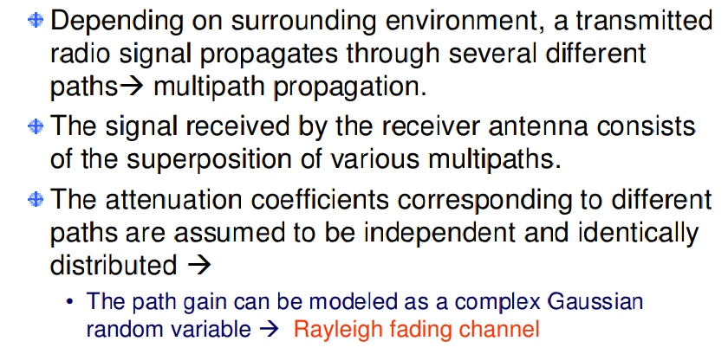
Introduction

Slide 3

Diversity Gain
Signal power in a wireless system fluctuates. When this signal power drops significantly, the channel is said to be in fade.
Diversity is used in wireless channels to combat the fading. Receive diversity and transmit diversity mitigate fading and significantly improve link quality.
The receive antennas see independently faded versions of the same signals. The receiver combines these signals so that the resultant signal exhibits considerably reduced amplitude fading.
Diversity order MR x MT MIMO turns multipath propagation into a benefit for the user

Slide 4
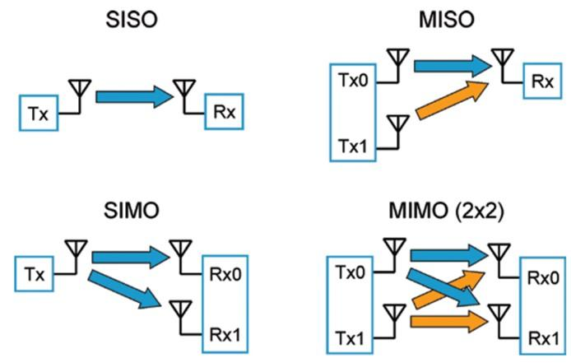
Multi-Antenna Systems

Slide 5
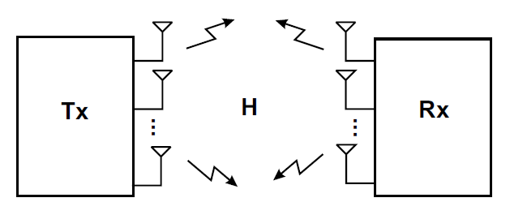
MIMO
MIMO Systems have multiple antennas at the transmitter and the receiver.
r receive antennas
t transmit antennas

Slide 6
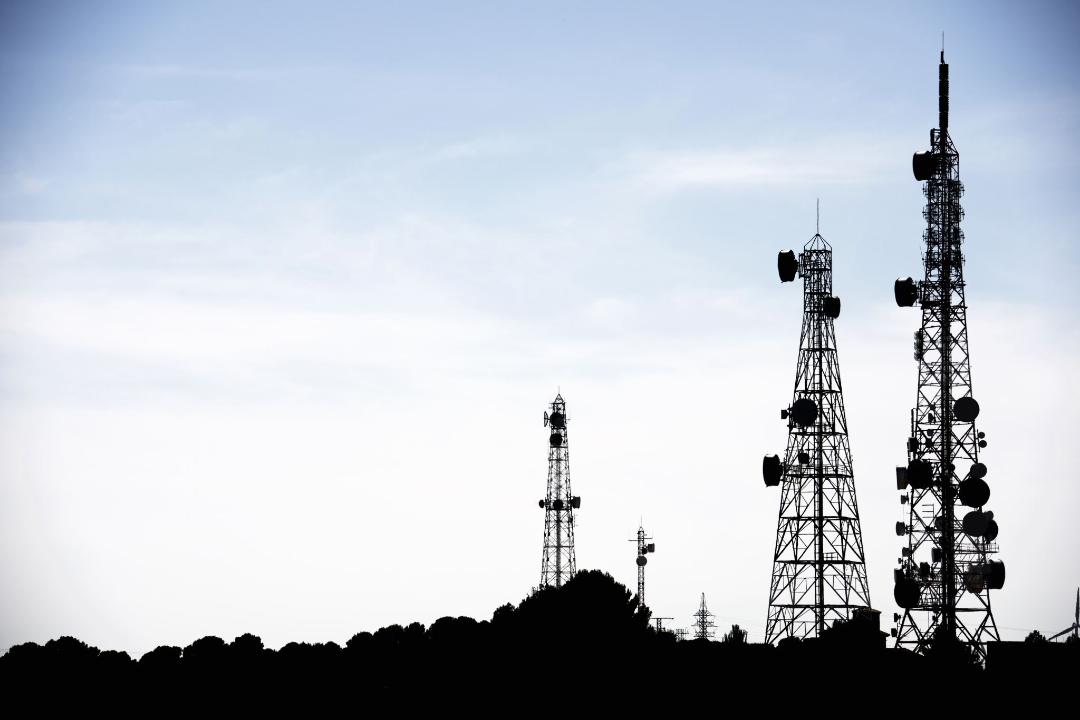
MIMO
As there are multiple antennas, MIMO systems can be employed for diversity gain.
MIMO can increase the data rate by transmitting several information streams in parallel
It is also known as spatial multiplexing as information is multiplexed over parallel streams in space
This is possible by using multidimensional signal processing

Slide 7
Generalized MIMO wireless communication system
Figure shows a line of sight (LOS) antenna setup of a MIMO system.

Slide 8
Why MIMO?
There is always a need for increase in performance in wireless systems
Significant increase in spectral efficiency and data rates
High Quality of Service (QoS)
Wide coverage, etc.
Wireless channel that we are using is very unfriendly
Suffers from Co–channel interference and signal level fading
It provides a limited bandwidth
power falls off with distance

Slide 9
SISO versus MIMO channel capacity
In SISO a system, the Shannon formula can be applied to determine the capacity of the system.
However, for a precise comparison, it is important that the MIMO system is transmitting with a power the same as that of a SISO system.
Therefore, if the power radiated by a SISO system is Ps (SNR), then the power radiated from each antenna of a MIMO system with NTX transmit antennas must be Ps/N.
The main importance of MIMO channel technique is to improve the capacity of the channel and therefore it is important to compare the capacity of a SISO system to MIMO system.

Slide 10
SISO versus MIMO channel capacity
SISO System
MIMO System
[1]
Where (*) means transpose-conjugate of H and H is the M x N channel matrix. I_{M} indicates the identity matrix of dimension N x M, in this case M = N =2 or more.
[1]. Sergio Barbarossa. Multiantenna Wireless Communication Systems. Boston, London: Artech House Inc; 2005.

Slide 11
Example 1
Suppose that the spectrum of a SISO communication channel is 1MHz and the signal-to-noise ratio is 24dB. Calculate the capacity of the SISO channel.

Slide 12
Example 2
Consider the 2x2 MIMO system, with the channel bandwidth of 1MHz and signals-to noise ratio of 24dB, Having a channel matrix

Slide 13
Representation of MIMO channel
2 x 2 MIMO system with channel characteristics
if the transmitted signal is represented to be X and the received signal Y. If the channel characteristics matrix is W_{c}, we may write

Slide 14

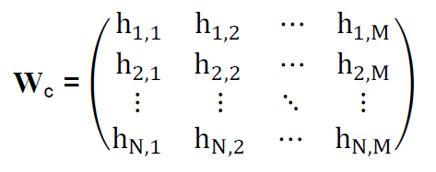
Representation of MIMO channel
If the channel matrix has N rows as many as there are transmitting antennas with index i. Then transmitted signal vector is written as
Also, if the channel matrix has M columns, as there are receiving antennas with index j. Then the received signal vector is
The channel matrix contains path characteristics h_{i,j} as

Slide 15
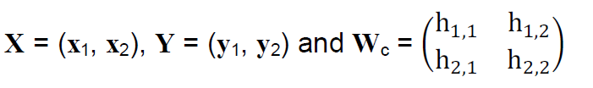
Example 3
Determine the relation for the transmitted signal X:

Slide 16
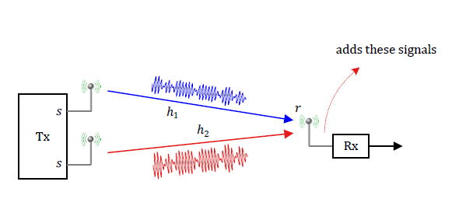

A Multiple-Input Single Output (MISO) System
The channel gains ℎ1 and ℎ2 are complex Gaussian random variables with uniformly distributed phases between 0 and 2π. Their sum also follows a Gaussian distribution with a uniform phase, i.e., h=ℎ1+ℎ2. We are facing a similar situation as a simple Rayleigh fading wireless channel! The conclusion is that there is no diversity gain in this setup.

Slide 17
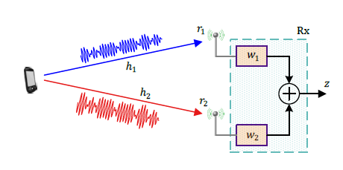
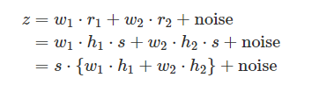

Maximum Ratio Combining (MRC)

Slide 18
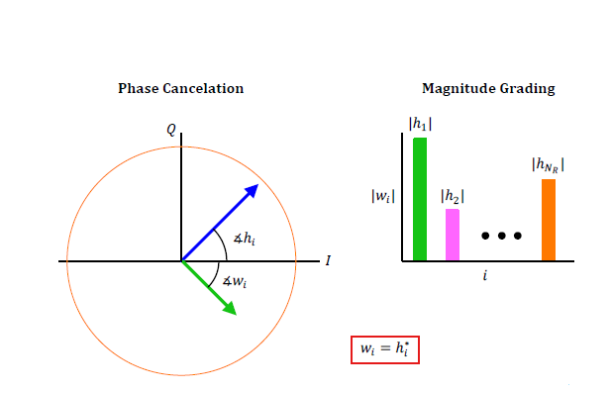
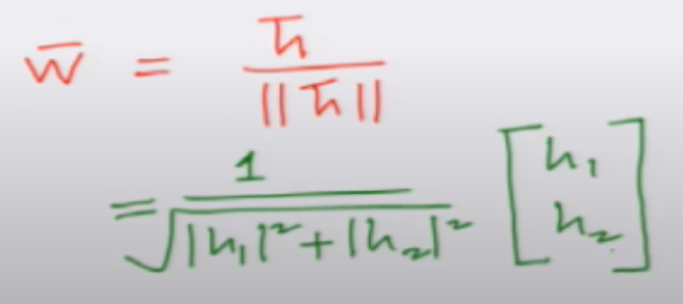
Maximum Ratio Combining (MRC)
w_i = (SNR_i)^2 / sum((SNR_j)^2)
The weight factor for each antenna is calculated as follows:
w = h* / (σ^2 + n^2)
where:
w is the weight factor for the antenna
h* is the complex conjugate of the received signal from the antenna
σ^2 is the noise power
n^2 is the interference power

Slide 19
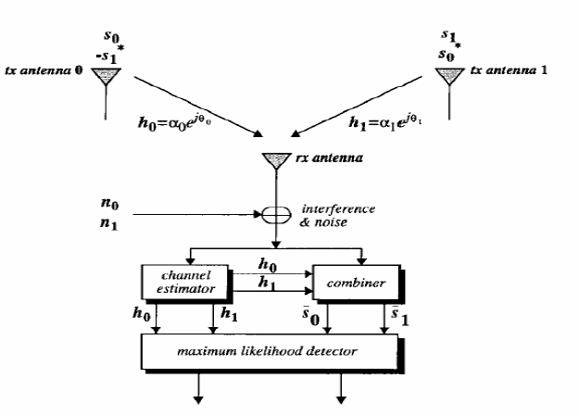
Alamouti code

Slide 20
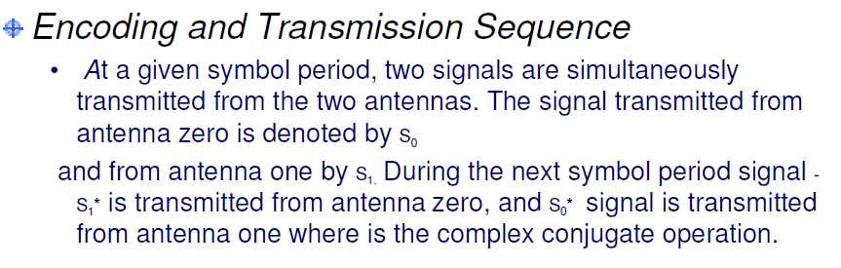
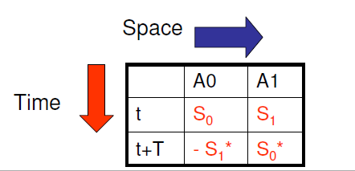
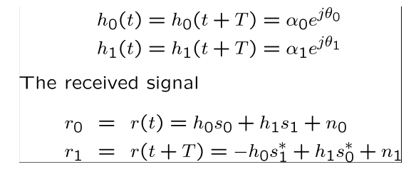
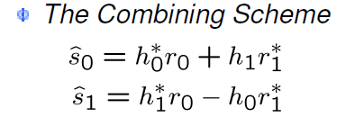
Alamouti code
Assuming that fading is constant across two consecutive symbols

Slide 21
Applications of MIMO technology
3GPP – Long Term Evolution (LTE)
Satellite Communication
IEEE 802.16e / WiMAX Standard
High frequency (HF) Band
IEEE 802.11n channel model

